Slide 1

Hammadh Arquil
2018128 - W1761780

Slide 2

Problem Background
Remote Patient Monitoring (RPM)
Allows healthcare providers and caretakers to view and monitor patient health information remotely from a distance and allow them to take the necessary steps to prevent the patient from deteriorating.
Increased access to care, Improved patient outcomes, Reduced healthcare costs
Global RPM systems market is projected to be worth over $1.7 billion by 2027
RPM systems hold huge potential for generating savings by preventing more severe and costly health outcomes from taking root.

Slide 3
Research Gap
Available Systems
Require physician-set thresholds to return any alerts
Due to the characteristics of the datasets available, some of the available studies have shown that their machine learning models did not give the desired performance.
Hybrid Models have not been employed in Remote Patient Monitoring applications.

Slide 4
Proposed Solution
Automated Health Status Assessment in Remote Patient Monitoring Systems using Hybrid Machine Learning techniques.

Slide 5
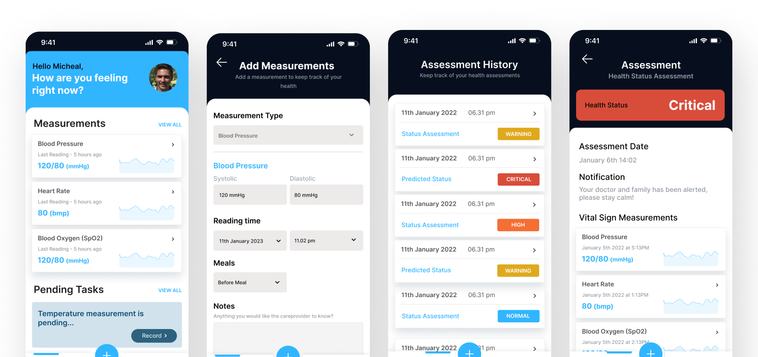

System User Interface

Slide 6
Progress & Future Plan
Progress and Future Plan to have everything completed towards the end of April
Current Progress
Basic Prototype of Health Status Classification is available
Began working on initial frontend of the system.
Future Plan
Improve performance of the hybrid classification model
Build a predictions model to assess patients health status at a future date and integrate it into the system
Work and complete the system Frontend to ensure good user experience with the system.
Host the models and work implement the APIs required for the system, Database integration aswell.
Work on testing & evaluation of the overall system

Slide 7
Thank you

